Slide 1
Preliminary Design Specification
OCdt Hebb
OCdt Stephan

Slide 2
Agenda
Problem Description
Requirements
Design overview
System Arch
Nodes to be used
Interfacing
Verification and Validation
Scheduling
Unresolved issues and risks

Slide 3
Problem Background
Brief overview of performance against each objective.

Slide 4
Requirements
Movement Toward Target
The TurtleBot and Flying Robot shall move toward a target under control.
Identification of Target
The robots shall recognize optically an OpenCV's ArUco shape and be able to give information on the location of the target relative to the robot.
Identification of Obstacle
The robots shall optically recognize obstacles in its environment and identify where they are relative to itself. The obstacle will be defined as any solid opaque object that is at least the height of the camera on the robot at the time of detection.
Avoiding Obstacles
The robots shall be able to make a deviation from its current movement pattern to avoid an obstacle in its path and then return to this pattern. The obstacle will be defined as any solid opaque object that is at least the height of the camera on the robot at the time of detection.
Multiple Obstacles
The robots should be able identify multiple obstacles and avoid them accordingly.

Slide 5
System Arch
Equp Table can go here
Block diagram of how each system will interact with each other
More general as the Nodes get broken down
More so how the bigger system interact

Slide 6
Nodes Description
Summary of Nodes
Driving
Camera/Video
Video Processor (OpenCV)

Slide 7
Interfacing
?

Slide 8
Verification and Validation
How we plan on testing the system
How we prove we met our requirements and are done

Slide 9
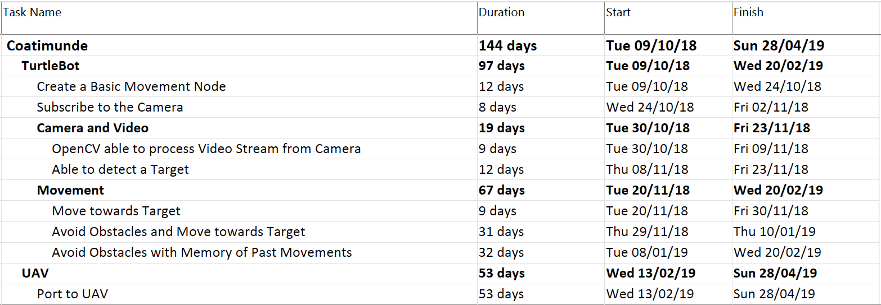
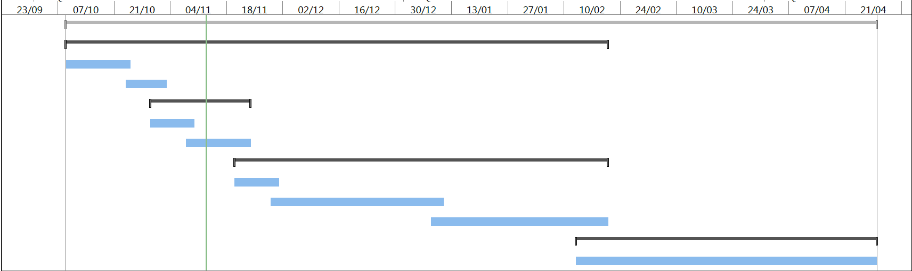
Scheduling

Slide 10
Unresolved Issues
Any issues we do not address

Slide 11
Risks
Identifying Markers
Computer Hardware Limitations
Flight Control System Inaccuracy

Slide 12
Summary
Summarize key requirements/solutions/challenges.
Ref SOR

